Slide 1
Flow considerations & Building Configuration

Slide 2
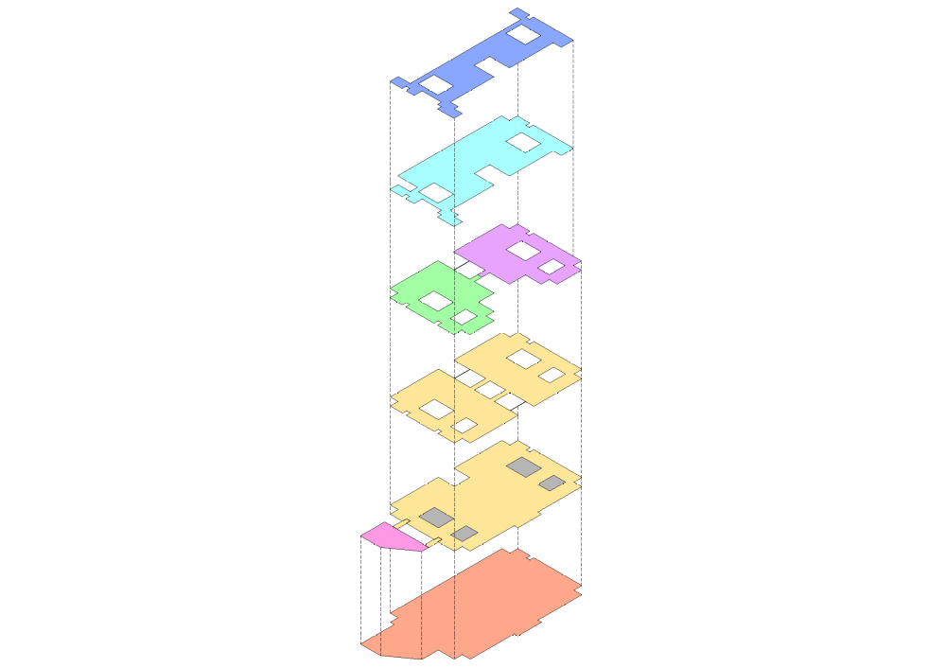
BUILDING CONFIGURATION
Level +4
AUDITORIUM & CLASSROOMS ON THE TOP FLOOR
FOURTH FLOOR
TEACHING & TRAINING FACILTY
THIRD FLOOR
OT COMPLEX
Level +3
OT COMPLEX WITH CSSD EXCLUSIVELY IN ONE FLOOR
SECOND FLOOR
IP ROOMS & WARDS
Level +2
IP IN A SINGLE FLOOR FOR FUNCTIONAL EASE
Level +1
FIRST FLOOR
OP CLINICS (PAYING)
FREE & PAYING OP CLINICS CONTAINED WITHIN TWO FLOORS
GROUND FLOOR
OP , IP REGISTRATION
& OP CLINICS (PAYING & FREE)
Level 0
BASEMENT FLOOR
PARKING
Level -1

